Slide 2
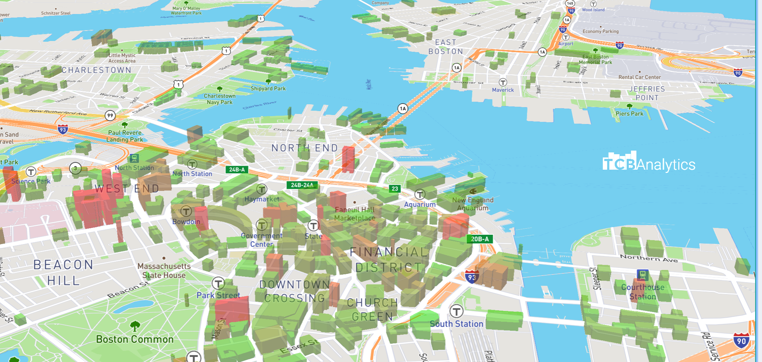
Beantown Solar: The Future Never Looked So Bright
Adam Jenkins, Tanya Cashorali, Patrick Brophy, James Mullen

Slide 3
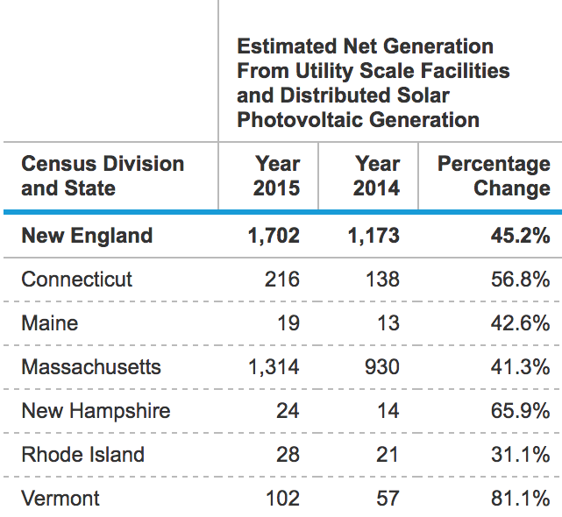
MERCURIAL RISe of solar in N.E.
-Among New England States, Massachusetts as a whole ranks 5th in year-over-year change
-Opportunities through leasing and tax rebates allow for high return on investment
-High start value in 2014 reduces our Y/Y change compared to other N.E. states
https://www.eia.gov/electricity/annual/

Slide 4
A Smart invest as costs fall
https://www.fool.com/investing/2017/04/28/is-this-stock-the-best-bargain-in-the-oil-sector-t.aspx

Slide 5
Questions AT HAND:
What is Boston’s Energy Situation?
Can We Plan For The Future?

Slide 6


Anatomy of solar predictions:

Slide 7
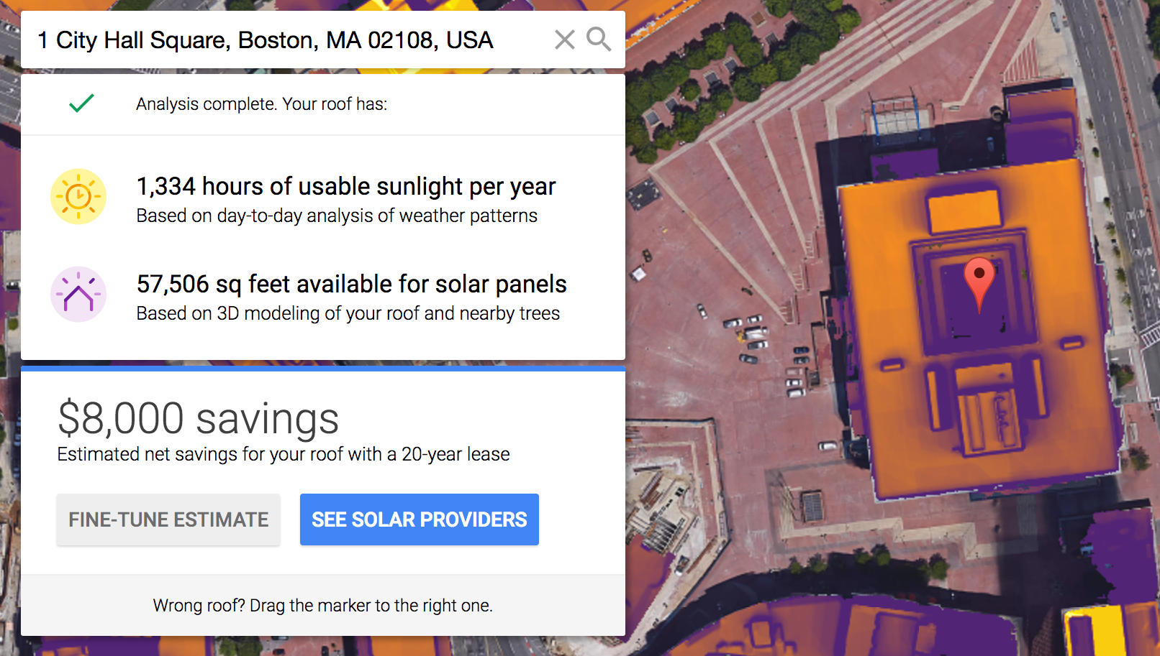
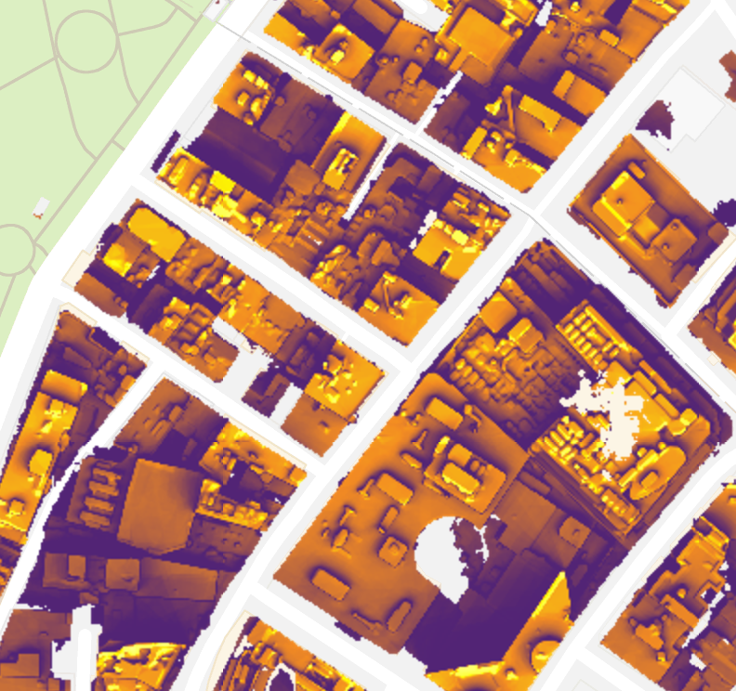
Boston BUILDINGS A TALE OF TWO CITIES
“Arid Desert”
Large Flat Roofs
Little shade or impediments
Maximum exposure
Easy installation of solar
“Mountainous Terrain”
Groups of smaller buildings
Lots of shadows and “decorations”
Sun exposure highly variable
Large installations not possible

Slide 8
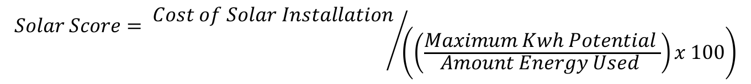
Data, Processes, assumptions
BERDO File
~1400 building’s energy usage documentation, lot size, etc.
Basis for energy usage levels
BPDA Document
Assets owned by the city that are available for usage
Project Sunroof
Sunlight exposure, roof sq. footage, maximum energy production
Boston ShapeFile
$$Solar Score= {Cost of Solar Installation}/{\left(\left(\frac{Maximum Kwh Potential }{Amount Energy Used }\right)x 100\right)}$$

Slide 9
Demo:

